Slide 1
Watch the Whisper
An Intersection of Speech, Computer Vision and Natural Language Processing
Jayesh Parikh
Karthik Srinivasan
Shobha Sankar
Notes:
Intro:
Voice is the sound produced using the lungs and the vocal folds in the larynx . Infants babble and coo and adults laugh, sing, and cry. Voice is generated by airflow from the lungs and pushed past the vocal folds. If the vocal folds in the larynx do not vibrate normally, speech could only be produced as a whisper.
Humans express feelings, and ideas orally through speech. Speech is produced by precisely coordinated muscle actions in the head, neck, chest, and abdomen.
My name is Shobha. And in this project “Watch the Whisper” Jayesh, Karthik and I’m exploring a promising solution to those who have lost their voice.

Slide 2
The Inaudible Voice
~ 7.5 Million Americans have voice disorders
Vocal cord paralysis
Surgical procedure
Viral infection
Hearing Loss not treated on time
Cancer resulting in Laryngectomy
This can result in
Partial or Complete loss of voice
Problems with pitch and volume
Affect the quality of voice
Notes:
Approximately 7.5 million people in the United States have trouble using their voices. These could be growths or inflammation and swelling in the vocal cords due to illness, injury or cancer. It can also be medical conditions that affect the nerve that control vocal chords. Hearing loss that goes untreated in early stages also can affect the ability to speak.
Disorders of the voice involve problems with pitch, loudness, and quality. Pitch is the highness or lowness of a sound based on the frequency of the sound waves. Loudness is the perceived volume (or amplitude) of the sound, while quality refers to the character or distinctive attributes of a sound. Many people who have normal speaking skills have great difficulty communicating when their vocal apparatus fails.

Slide 3
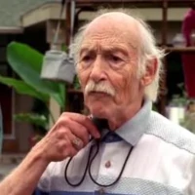
Building Communication
Loss of Voice directly affects the quality of life
Basic communication becomes an issue
Reconstruction of basic communication
The speech aid must adjust to user’s lifestyle
Natural extension
Easy to operate
Artificial larynx device
Electronic Speech Aid
With Volume Control
Notes:
Complete loss of the natural voice directly affects the basic communication functions in daily life. Reconstructing the basic communication function is an important issue for these patients.
When thinking about the rehab of the patient who has lost their voice, we need to keep a few factors in mind. The speech aid must adjust to the user’s lifestyle and must be a natural extension of them. It must be simple to use or easy to operate.
Artificial larynx device (https://www.youtube.com/watch?v=AYydnhu6NbU)
Now let us look at some of the solutions used by these patients today.
First one is an artificial larynx used by patients who have lost their voice due to laryngectomy. The electrolarynx is an external device that induces vibration of oral cavity at a constant fundamental frequency. Muscles of articulation such as tongue and lips are, generally, intact after Laryngectomy and thus amenable to shaping the supplied vibration noise into understandable speech.

Slide 4
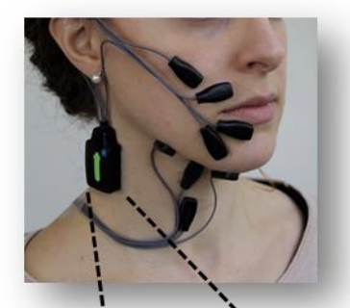
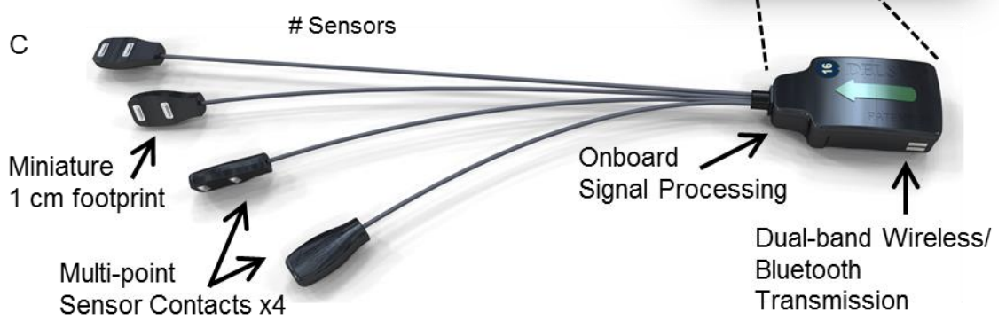
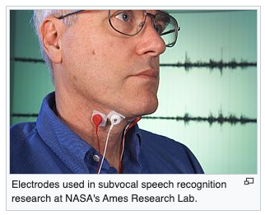
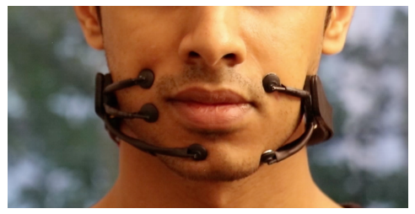
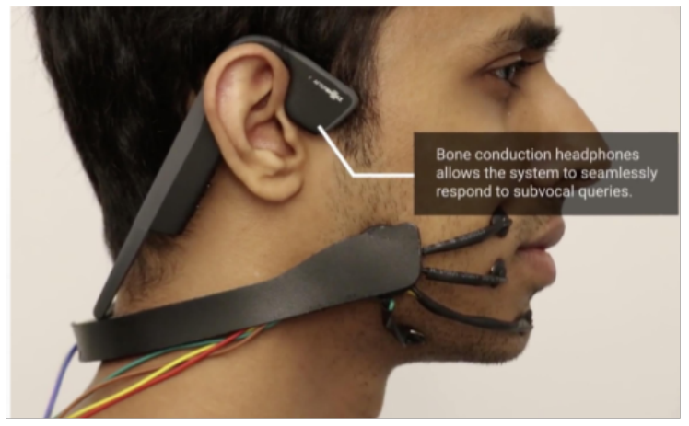
Wearable Lip Reading
Surface Electromyographic (sEMG)
Subvocal Recognition
Latest Surface EMG (MIT Labs)
AlterEgo (Developed by MIT labs)
Indiscernible Silent Speech Recognition
Private and personal machine interface
Internally vocalized phrase recognized by computer
Computed output aurally transmitted back to user
Notes:
The newer innovations focus on silent speech recognition. With patients that have a functional larynx the digital recognitions rates of the spoken words using laryngeal EMG are as high as 90% but they suffer from ambient noise. Instead other innovation focus on articulatory tract such as mouth, tongue and palate movements of the patients. Subvocal recognition uses human silent reading nerve signals in the throat that control the speech and digitize it using the button sized sensors.
Delsys surface electromyography (sEMG) signals records from the muscles of the face and neck recognize and uses an algorithm to recognize isolated words and uses a grammar model to make sentences. It uses a phoneme-based model for untrained words.
The latest Alterego my MIT labs use a similar sEMG solution with an aural feedback to the user which makes in private and personal.

Slide 5
Drawbacks
Electrolarynx devices have
Monotonic voice
A mechanical hum radiating from the device
Not very easy to use
Wearable Lip Reading solutions
are complex
Surface EMG is susceptible to ambient noise
Can Computer Vision solve this problem?
Notes:
The current solutions discussed have several drawbacks. For example, the drawback of electrolarynx devices includes a mechanical hum radiating from the device that is not filtered by the vocal tract and instead is perceived directly by the listener. Some noise reduction techniques have been developed over the years to reduce this noise and give the human voice richer intonation instead of a robotic monotone.
It’s also not very easy to use and those that involve inserting the tube in the mouth can be unhygienic.
On the other hand, wearable solutions are complex and the technology that picks up signals using surface EMG can be susceptible to ambient noise.
So that leaves us with a new approach using image processing of lip movement. This is what we wanted to explore. Next Karthik will explain the details of our exploration and selection of our approach.

Slide 6
Literature Survey
Lip read CNN of visemes from still images [1]
Character prediction in sentence being spoken from video with or w/o audio [2]
Full word recognition using LSTM classifiers [3]
Current work uses [2] with focus on video only
[1] Koller et al, Deep learning of mouth shapes for sign language, 2015
[2] Chung et al, Lip reading sentences in the wild, 2017
[3] Petridis and Pantic, Deep complementary bottleneck features for visual speech recognition, 2016
Notes:
[1] Use of visemes from still images to predict the output text. Pros: smaller classification problem; Cons no temporal connectivity;
[2] sequence of images to predict characters. The method uses a self attention model and CTC classification to help with training on datasets w/o supervised labeling of characters. Additionally language models can be used to augment the output probabilities
[3] Use word recognition instead of character. Uses an LSTM but was trained on a very small dataset. LSTM has issues with train times on large train datsets

Slide 7
Large Scale Datasets
Lip reading in the wild (LRW) [1]
The dataset consists of up to 1000 utterances of 500 different words, spoken by hundreds of different speakers. All videos are 29 frames (1.16 seconds) in length, and the word occurs in the middle of the video (visualization link)
Lip reading sentences in the wild (LRS-2) [2]
The dataset consists of thousands of spoken sentences from BBC television. Each sentences is up to 100 characters in length
Lip reading sentences in the wild (LRS-3) [3]
The dataset consists of thousands of spoken sentences from TED and TEDx videos
[1] Chung and Zisserman, Lip Reading in the Wild, 2016
[2] Chung et al, Lip Reading Sentences in the Wild , 2016
[3] Afouras et al, LRS3-TED: a large-scale dataset for visual speech recognition, 2018
Notes:
There are a few datasets built towards visual speech recognition. The most comprehensive ones are those put together by researchers in oxford. They have annotated words/sentences from BBC and a few TED talks. The main drawback of these datasets are the localized nature of the train samples. For example, BBC videos mainly feature british news and media personalities possibly introducing bias in the model (https://www.robots.ox.ac.uk/~vgg/data/lip_reading/visualisation.htm)

Slide 8
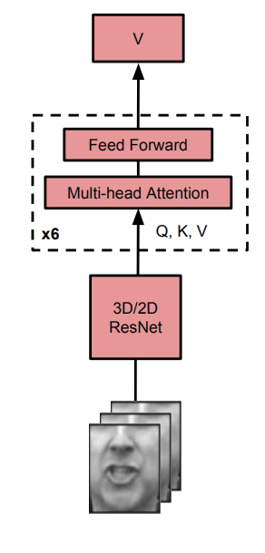
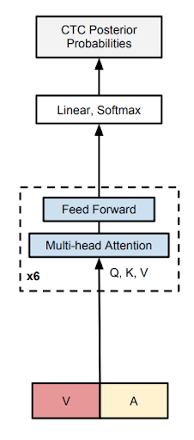
Neural Architecture
40 output classes, (A-Z; 0-9;blank; apostrophe; <EOS>)
Pretrained VF Model; Can be used for transfer learning
~37M trainable parameters;
External character language models can be used to correct/augent the CTC probabilities
V
Visual FrontEnd (VF) Encoder
CTC* Decoder
Afouras et al, Deep Audio Visual Speech Recognition, 2018
* Connectionist Temporal Classification (CTC): Training of RNNs without the need for pre-segmented learning data
Notes:
Visual frontend decoder takes in images resized to 224 x 224 @ 25 frames per sec. The images are center-cropped to 112 x 112. A bunch of 5 frames are passed into the 3D resnet CNN . T x H x W is condensed to T x H/32 x W/32 x 512 tensor, and then average pooled into a T x 512 vector. Temporal resolution is maintained. This resultant vector goes through a self attention network to produce an encoded vector. The encoded vector then passed through another self attention network. The final layer is a softmax layer that results in posterior probabilities of each character (A-Z, 0 to 9, ‘ ‘,’’’, ‘<EOS>). 37M trainable parameters

Slide 9
Model Train & Validation
Curriculum training
Model is trained sequentially using 1-word, 2-words...37 words at a time. In all 11 different configurations were run. This is followed by training on whole sentences
Pretrained visual front end ResNet used; rest of the network is trained from scratch
Training times ~ 11 days on the LRS2 dataset on a P100 GPU, ~100GB of train data
Word Error Rate (WER) of 57% achieved on LRS2 test dataset
State of art video-only models achieve ~ 49-54%
State of art audio-video models achieve ~6-7%
Human lip readers ~88%
Notes:
Key aspect of the training routine is the use of curriculum training. The network is trained sequentially using (1,2,3,5,7,9,13,17,21,29,37). The pretraining at each step is run until WER stabilizes/saturates. The pretrained model is then used as a initial checkpoint for the next stage of curriculum training. The process is repeated 11 times. It approx takes 11 days to complete this and a further 3-4 hours on full training. The training was carried out on P100 ibm cloud workstations.
A WER of 57% was achieved on LRS2 test dataset. Human’s end up with a WER of 88%. This is quite a difficult task where the ML models far outperform humans. Usually in computer vision problems, it’s mostly the other way around. Using just audio to predict the phonemes is reasonably good @ 7% error rate.

Slide 10

Network Architecture
IBM Cloud (P100)
Jetson TX2
MQTT
Broker
MQTT
Broker
USB Cam
Inference / Video Saver
Model
Video Capture (OpenCV)
Object Storage
Capture Video using USB Camera
Send to the Cloud using MQTT Broker
Video received via MQTT Broker
Video Saved on Object Storage
Lip Reading Inference

Slide 11

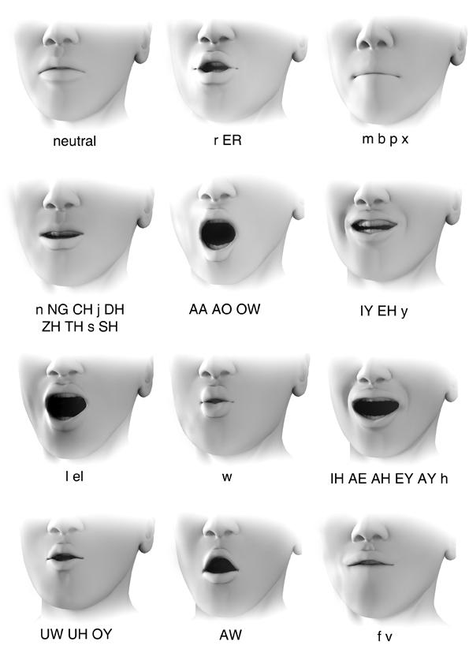





Inference
Ground Truth: When I make my pastry
Prediction: When I make my pantrick
Link
Ground Truth: Morning
Prediction: More ing
Ground Truth: Morning
Prediction: Its boring
Ground Truth: Its that simple
Prediction: Its that simple
Ground Truth: How are you
Prediction: On and are you
Ground Truth: Its a wonderful day
Prediction: Its work of art the
Notes:
- Difficult task to infer
- Teaches how to lip read, matches reasonably well.
- character based model so does not correct words
- 3rd is better
- same viseme for different phoneme

Slide 12

Observations
Inherent bias on accents
Dataset limited to BBC videos
Need appropriate speech speed
Single viseme for multiple phonemes causes confusion
Need curriculum learning for training convergence
Inference on the edge device was too slow
Notes:
LSR2 dataset was based on BBC videos which was used for training. This introduced some bias towards certain accents (i.e. how the lips movement is observed)
How fast someone speaks can affect how the model infers
Single viseme for multiple phonemes as stated earlier causes confusion
Curriculum learning was required for training convergence (11 different configurations)
Running inference on the edge device was too slow, ran out of time for TensorRT conversion

Slide 13

Multi-modality (adding audio to augment training)
Personalizing the model to read the user better
Inference on the Edge (PyTorch/TensorRT)
Language Model that corrects sentences, implements spell checker
Notes:
Current model is based on predicting next set of characters
Trained using video, but result may be better if trained on both audio and video. Training using personalized video may help in lip reading the user better
Inference on the edge

Slide 14
Thank You!
Questions?

Slide 15
Appendix

Slide 16
Glossary
Phoneme: Smallest distinguishable unit of sound that collectively make up a spoken word
Viseme: Visual equivalent of Phoneme
Word Error Rate (WER): Defined as WER = (S+D+I)/N, where S, D and I are the number of substitutions, deletions, and insertions
Notes:
Computer Vision allow us to building systems that can learn, infer and reason about the world from visual data alone.
what part does language play in the creation and recreation of intelligence?
We can at least say that vision and language are inextricably intertwined, from an evolutionary standpoint, with the human experience.
For instance, when the concept of a ‘dog’ is evoked in your mind, there are numerous different associations around the nexus of cat almost instantly. Such as:
An image of a generic dog or a specific dog
The sound “dog”
The feeling of petting a dog
The letters d, o, g
Sometimes-first loyal friend, obedient, eager-to-please creature
these basic experiences inform our understanding of what a dog is and its relationship to us. Many of our recollection and articulation of experiences involve language.
This means we can enable processes in machines involving multiple modalities like in this case computer vision and NLP

Slide 17
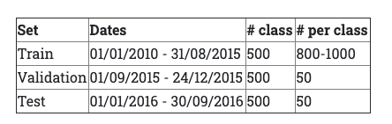
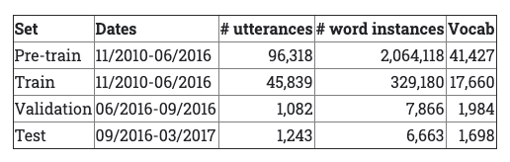
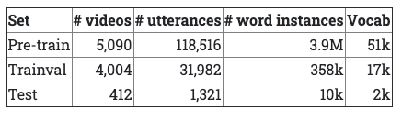
Datasets
LRW
LRS2
LRS3
Notes:
Computer Vision allow us to building systems that can learn, infer and reason about the world from visual data alone.
what part does language play in the creation and recreation of intelligence?
We can at least say that vision and language are inextricably intertwined, from an evolutionary standpoint, with the human experience.
For instance, when the concept of a ‘dog’ is evoked in your mind, there are numerous different associations around the nexus of cat almost instantly. Such as:
An image of a generic dog or a specific dog
The sound “dog”
The feeling of petting a dog
The letters d, o, g
Sometimes-first loyal friend, obedient, eager-to-please creature
these basic experiences inform our understanding of what a dog is and its relationship to us. Many of our recollection and articulation of experiences involve language.
This means we can enable processes in machines involving multiple modalities like in this case computer vision and NLP

